Slide 1
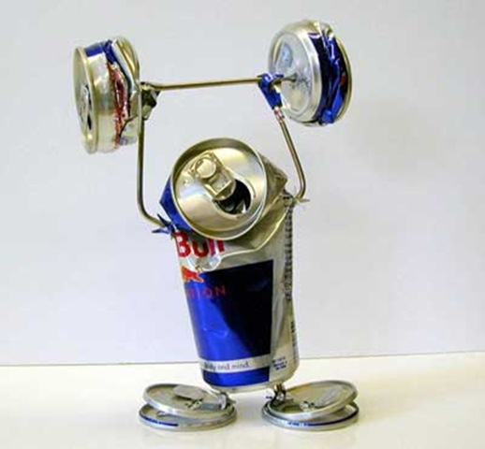

Cutting Electricity Cost For Service Provider Networks
Muhammad Saqib Ilyas
FDC
Zartash Afzal Uzmi
Tariq Mahmood Jadoon
Ihsan Ayyub Qazi
Muhamad Fareed Zaffar
Aamir Qayyum

Slide 2
Agenda
Background and motivation
Opportunity and key idea
Case studies:
Data centers (e.g., Facebook and Google)
Cellular networks (e.g., Sprint and Verizon)
Conclusions and future work

Slide 3

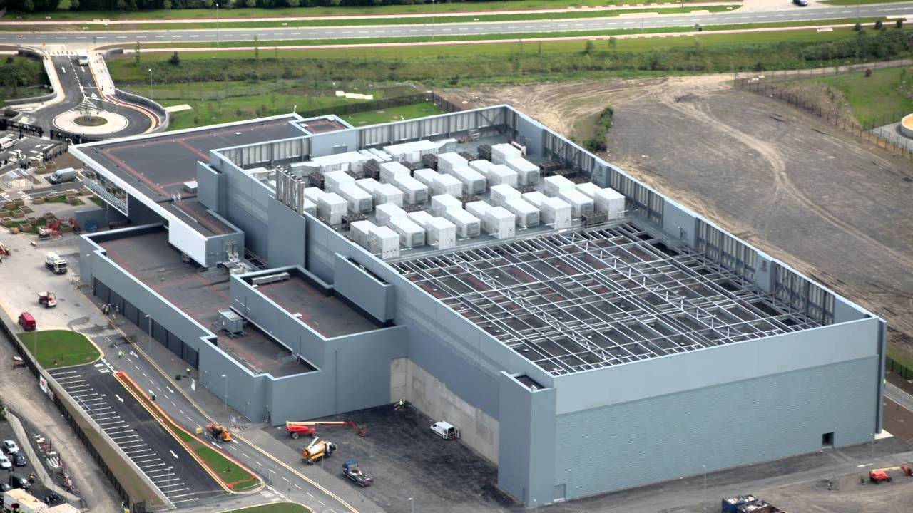
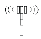
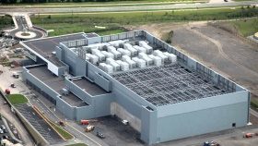

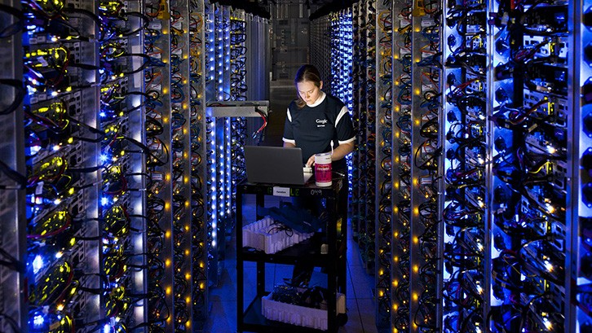
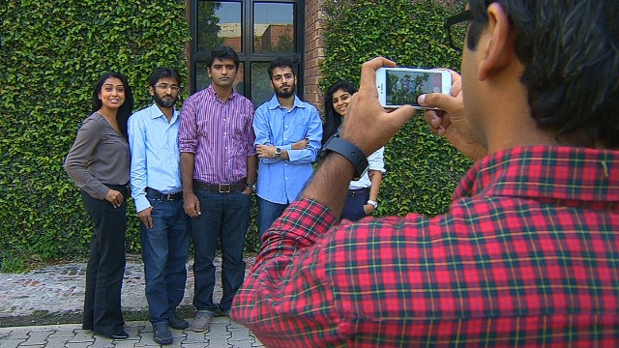

Background
Federated networks empower communication
A YouTube data center
The Internet
Source: vcetsiras.blogspot.com
Source: sekho.com.pk
Source: flaticon.com
Source: freeimages.com
Source: cnet.com
Source: youtube.com

Slide 4
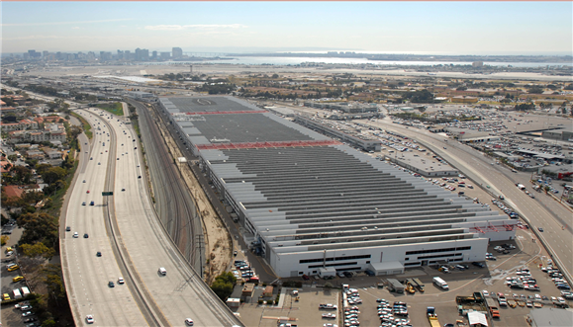
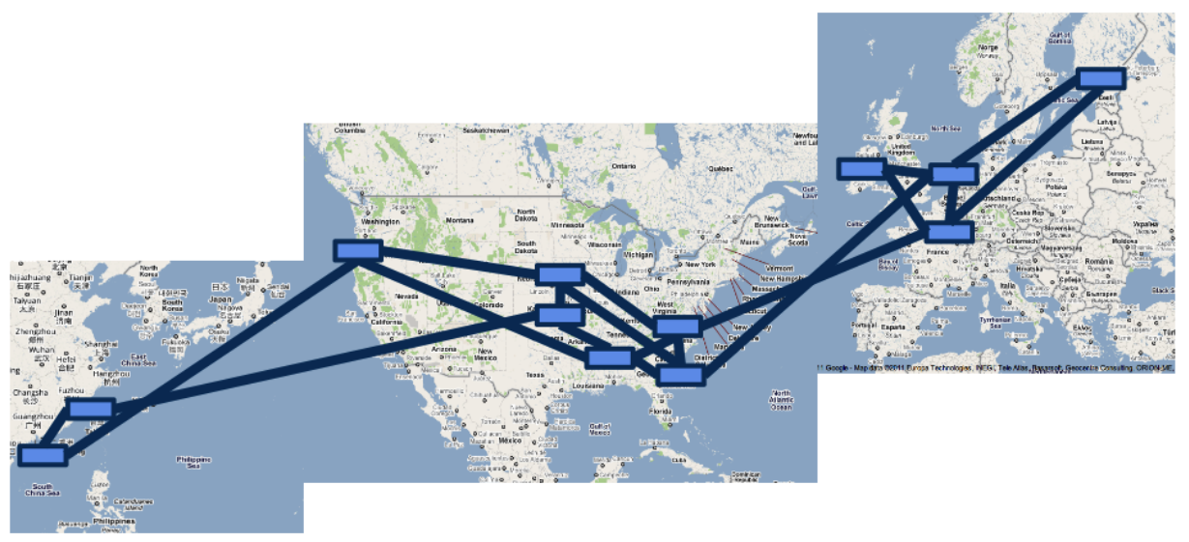
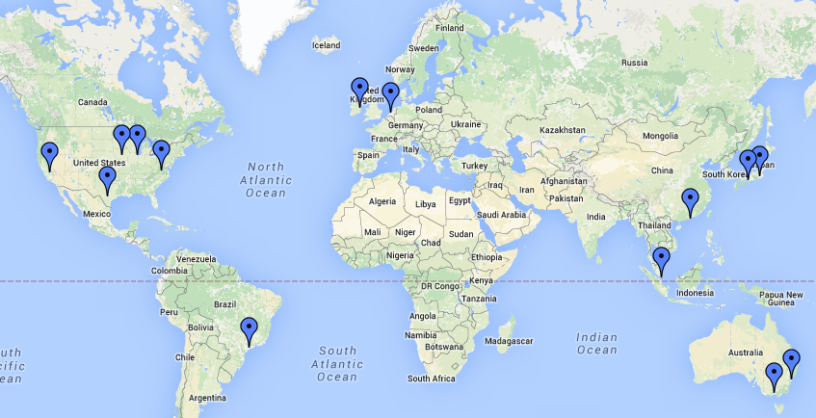
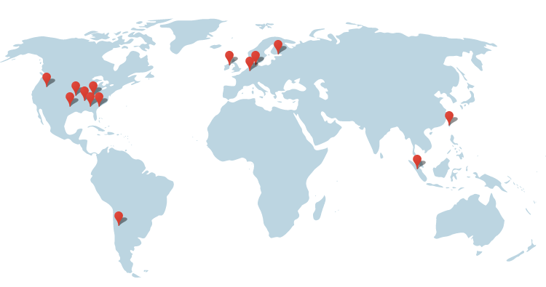

Network Scale
1 Data Center ~ 50,000 - 80,000 servers
Rich connectivity
Parameter | Microsoft | Amazon | Google
Servers | Millions | 2.8 – 5.6 M | 900000
Data Centers | > 26 | ~ 87 | 14
With great power comes
Telenor: 8000 cell sites
Data Center
Inter Data Center Links
Massive infrastructure
Massive power draw
great electricity bills
Google’s data center locations
http://bit.ly/1WbIvbe
Google’s B4 SDN
Image Source: Jain et. al, “B4: Experience with a globally-deployed software defined WAN”
Microsoft Azure’s data center locations
http://bit.ly/1mqvi26
Image source: http://bit.ly/1awWnLn

Slide 5


Motivation
Electricity Bill
15%
Annual DC Opex
$951 M
Electricity Cost
$143 M
Electricity Bill
Upto 50%
Electricity Cost 2012
$81 M
Significant electricity costs
Source: Greenberg et. al, “Cost of a cloud: Research Problems in Data Center Networks”, CCR 2009
Source: datacenterknowledge.com
Source: GREENNETS

Slide 6
Agenda
Background and motivation
Opportunity and key idea
Case studies:
Data centers (e.g., Facebook and Google)
Cellular networks (e.g., Sprint and Verizon)
Conclusions and future work

Slide 7
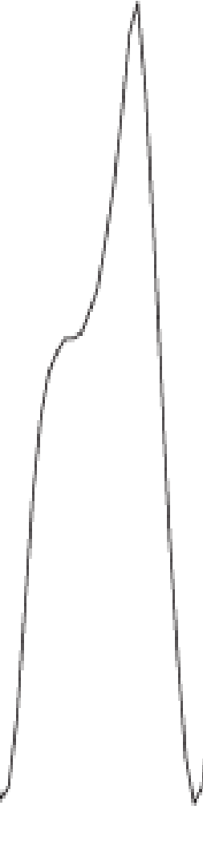
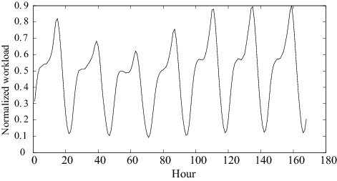
Opportunity
Network provisioned according to peak
Google: Search queries
Google: Enough servers, storage and bw to handle peak
Diurnal cycles
DC Idle power
75%-85% of peak power
Traffic Volume
Power consumption (Watt)
Opportunity for electricity cost savings
Most equipment (nearly) idle
Workload
Time
Peak and trough are quite pronounced
Barroso et. al, “The Case for Energy Proportional Computing”, IEEE Computer, 2007
Peng et. al, “Traffic-Driven Power Savings in Operational 3G Cellular Networks”, MOBICOM 2011
Source: Emerson, “Energy Logic: Reducing Data Center Power Consumption…”

Slide 8
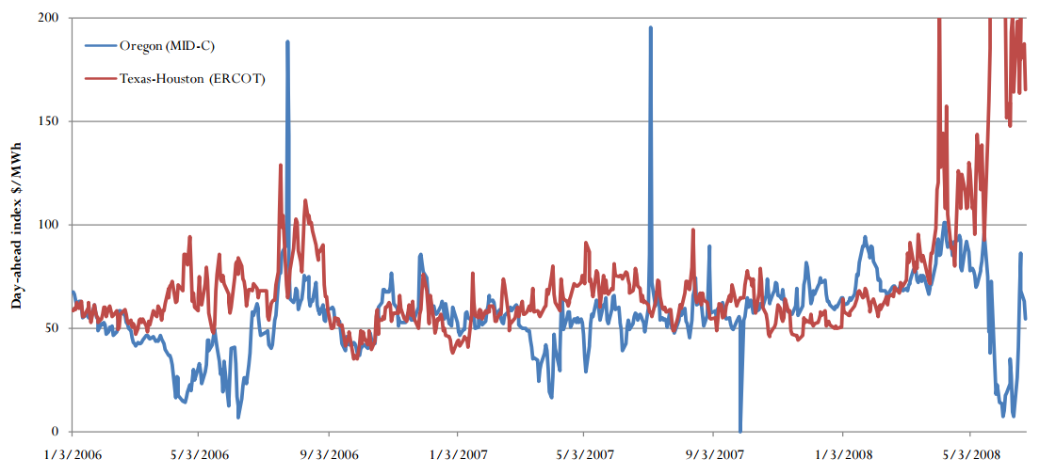

Key Idea
Deactivate idle equipment
When workload rises even more …
RP to save more
Geographic diversity in electricity prices
CA: California
Workload relocation (WR)
Deactivate some equipment
As workload rises…
Data Center
NY: New York
TX: Texas
Workload
Move workload from NY to TX
Most expensive
Temporal diversity in electricity prices
122.4
Resource pruning cuts electricity cost
RP and WR can cut electricity costs
Electricity price
$/MWh
72
52
NY
TX
CA
Ain’t no such thing as a free lunch
Least expensive
Workload relocation cuts electricity cost further
A. Qureshi et. al, “Plugging into energy market diversity”, HOTNETS 2008
Notes:
Bigger. Photo of a real data center then zoom

Slide 9
Transition Costs
Workload relocation overheads
E.g., Cost of data transfers
Expensive inter-data center links
Equipment activation and de-activation overheads
E.g., Energy spent while resuming and sleeping
Must consider transition costs while optimizing
Relocate Energy Demand to Better Locations (RED-BL)

Slide 10
This Thesis
Towards systematic minimization of network electricity cost
using Workload Relocation (WR) and Resource Pruning (RP)
while considering transition costs
Notes:
Abbreviate. Single thesis statement
This thesis uses (boxes) WR and RP with consideration of relocation and (transition) costs by developing a systematic framework for electricity cost minimization

Slide 11
Contributions
Optimal state trajectory formulation [1]
Considered transition costs [1]
Evaluation of cost savings under various scenarios using real traces [1]
Evaluated impact of prediction accuracy on savings [1]
[1] “RED-BL: Energy Solution for Loading Data Centers”, Infocom 2013 mini-conference

Slide 12
Contributions
Evaluation of RED-BL with:
Partial data center shutdown [2]
Sleep modes [2]
Sliding window re-optimization [2]
Granular deactivation of data center equipment [2]
Showed that RED-BL (for data centers) is the NP-Complete unit commit problem [2]
[2] “RED-BL: Evaluating Dynamic Right Sizing for Data Center Networks”, Elsevier Computer Networks, 2014

Slide 13
Contributions
Application of state trajectory optimization to cellular networks [2, 3]
Showed that RED-BL for cellular networks is NP-Hard [4]
Evaluated RED-BL using traces from a live network [3, 4]
[3] “Electricity Cost Efficient Workload Mapping”, IEEE INFOCOM 2013 Computer Communications Workshop
[4] “Low-Carb: Reducing Energy Consumption in Operational Cellular Networks” IEEE GLOBECOM 2013

Slide 14
Agenda
Background and motivation
Opportunity and key idea
Case studies:
Data centers (e.g., Facebook and Google)
Cellular networks (e.g., Sprint and Verizon)
Conclusions and future work

Slide 15
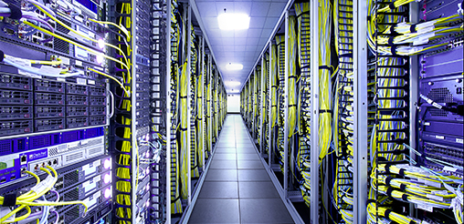
Case Study – I : Background
Data center operator
Geographically distributed data centers
Data center equipment
Power drawn is affine function of workload
IT Load | Non-IT Load
Servers | Lighting
Storage | Cooling
Network | Power distribution
Let’s recap how we can use WR and RP
Source: http://bit.ly/1mrIi7o
Notes:
Photo

Slide 16
Problem Model
Data center deactivation
Interval - 1
Interval - 2
Interval - 3
NY
TX
TX
CA
8
6
CA
NY
TX
NY
CA
12
10
10
Electricity price driven workload assignment
Transition cost
Optimal State Trajectory Problem
State cost locally suboptimal
State cost locally suboptimal
Total cost: 46
State cost locally suboptimal
Network State
State Cost
Data center activation
Locally optimal
Might not be globally optimal
Transition costs lower than local optimal scheme
No transition costs
Relocate Energy Demand to Better Locations (RED-BL)
An alternative workload mapping
Total cost: 42
Sum of all data centers’ electricity cost
NY
TX
TX
CA
4
CA
0
NY
TX
NY
CA
14
12
12

Slide 17
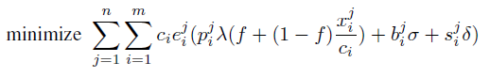
Optimization Formulation
Fraction of data center that is active
Unit price of electricity
Workload
Data center capacity
Sum over all intervals
Sum over all data centers
State energy
Transition energy
Subject to several constraints (please see the thesis)
Notes:
Give the objective function and the constraints

Slide 18
Experimental Setup
Workload from 3 popular Facebook apps
Electricity prices from 33 US locations
Simulated a week-long deployment plan
Compared RED-BL against various schemes
Notes:
To evaluate RED-BL for geo-diverse data centers, we performed a simulation study which had the following setup. We used workload from three popular Facebook applications and normalized the cumulative workload. We verified that the characteristics of the cumulative workload resemble that of the workload for thousands of servers in a Google data center. We collected day-ahead electricity prices for 33 locations across the USA and simulated a weeklong deployment plan for the data centers situated at these locations. We compared RED-BL against a number of algorithms.

Slide 19
Comparison Benchmarks
1
3
0
2
0
2
UNIFORM: Equally distribute workload
3
1
2
1
3
15
15
20
1
3
0
2
0
2
LO: Local Optimal Ignoring Transition Costs
3
1
2
12
1
10
10
3
Theoretical lower bound
1
3
8
2
6
2
LD: Local Optimal with Deactivation
3
1
2
12
1
10
10
3
Sometimes idling is better
1
3
4
2
6
2
LS: Local Optimal with Selection
3
1
2
15
1
10
10
3
Best practical variant of local optimal

Slide 20
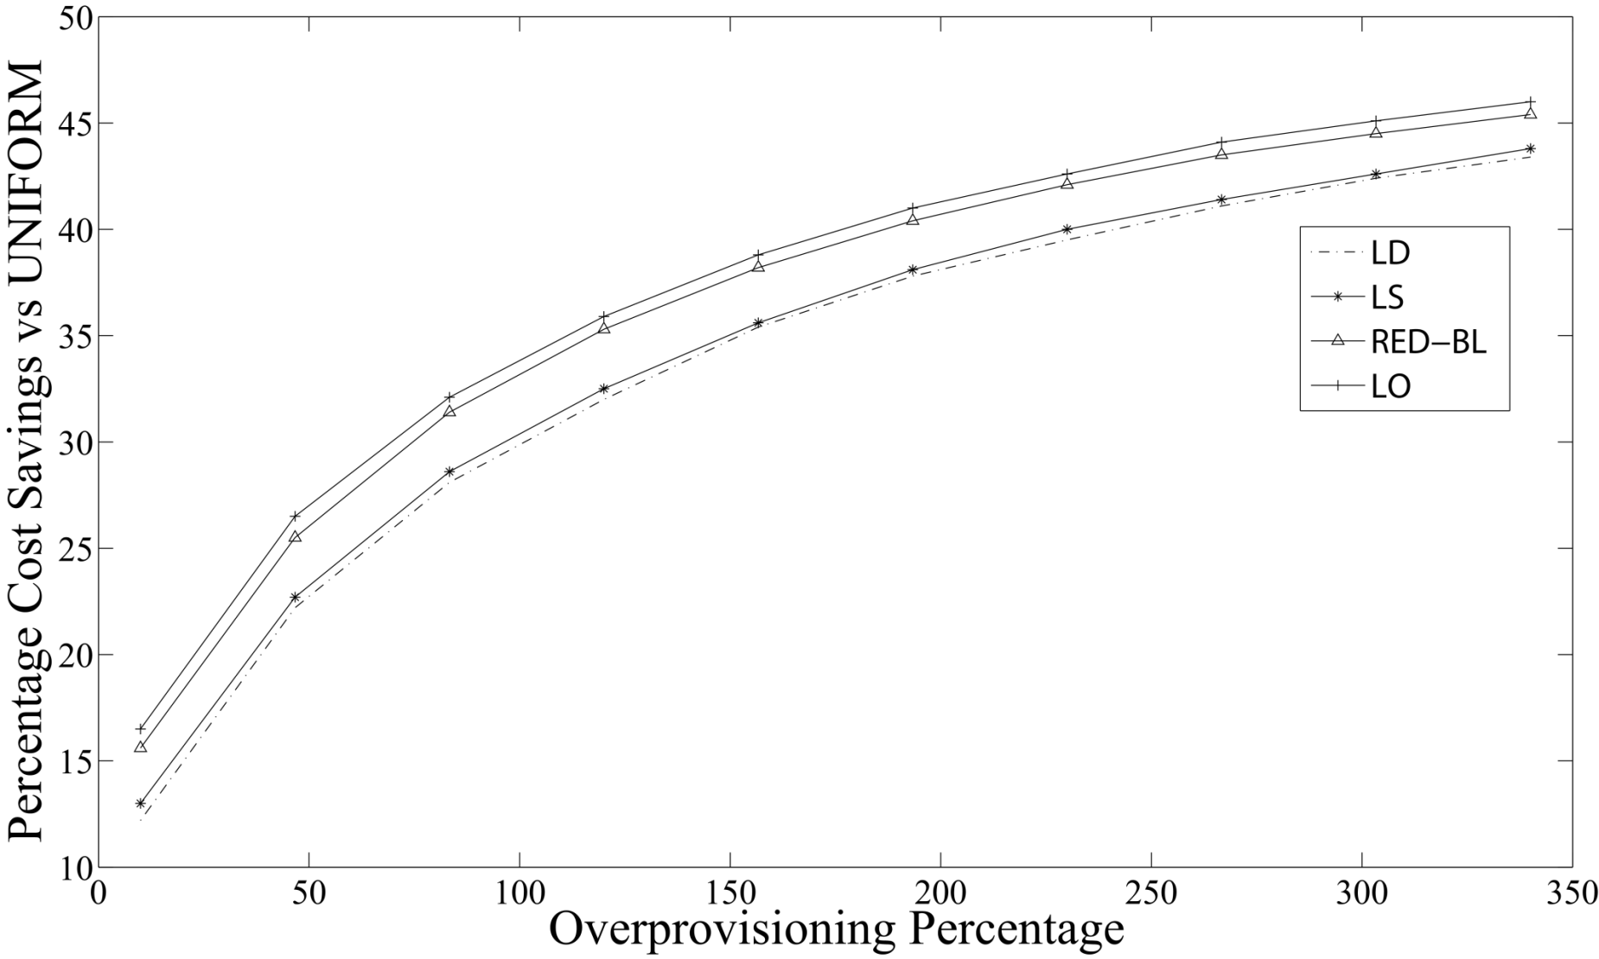
Cost Savings vs Over-provisioning
RED-BL close to ideal savings
Falsely predicts high savings
Actual savings 10.35% lower
50% over provisioning => 26% Savings

Slide 21
Electricity Cost vs Transition Cost
Gap widens rapidly
Near optimal savings
No transition costs
(De)activation overhead = energy cost
Notes:
As the magnitude of transition overheads compared to the cost of handling workload increases, we see that the percentage savings in electricity cost decrease for all algorithms. RED-BL achieves close to the ideal lower bound electricity cost savings, whereas the best variants of the greedy algorithm scale worse than RED-BL.

Slide 22
Granular (De)activation
Cost savings over full data center (de)activation
Opportunity for greater savings
Can only (de)activate entire data center
Can (de)activate half a data center
Notes:
Now, let’s see how RED-BL energy savings would improve if we allowed independent (de)activation of fixed size fractions of a data center. The extreme right handside of this graph represents the case where you can only (de)activate an entire data center at a time. This is 0% better than the standard “all or nothing” RED-BL, because it is the same thing. If we were able to (de)activate half a data center at a time, we could do about 2.5% better than standard RED-BL. If we were able to independently (de)activate 10% of a data center at a time, we could do 5% better than standard RED-BL. So, there is opportunity for greater savings with granular (de)activation and it has a linear trend.

Slide 23
DVFS Instead of Deactivation
Notes:
If, instead of shutting down an entire data center, we switch the servers into lower-power mode using DVFS techniques, the power savings might reduce, but the scheme would be more agile to workload variations. Here, we see that the power consumption drops linear as the power consumption is lowered with DVFS. If the server power consumption drops to 10% of the peak, the data center power consumption would be reduced by about 70%. Another data point is that if we put all “idle” servers at 50% power consumption, we achieve about 20% power reduction.

Slide 24
Reserve Margin
Notes:
To be prepared for some stray workload at data centers which we planned to deactivate, we’ll keep some servers on as reserve. As we increase the amount of serving capacity in reserve mode, the difference in power consumption will increase compared to the scenario where we did not keep any reserve capacity.
Exactly how much “stray” traffic we receive can’t be predicted. In this chart, the lower line shows the situation where we don’t receive any stray traffic at all. The power consumption in that case is purely due to servers idling. The upper line represents the situation where we need all the reserve capacity for handling stray traffic. The actual situation may be somewhere in between.

Slide 25
Summary – Case Study I
Significant cost savings are possible using RED-BL
Finer granularity of resource (de)activation increases savings
Low-power mode instead of shutdown also helps considerably
Cost savings decrease sharply with reserve margin
Can we apply this optimization “machinery” to other networks?

Slide 26
Agenda
Background and motivation
Opportunity and key idea
Case studies:
Data centers (e.g., Facebook and Google)
Cellular networks (e.g., Sprint and Verizon)
Conclusions and future work

Slide 27

Case Study II Cellular Networks
15%-80% of total power consumption
TRXs
Power amplifiers
Air conditioning
BSC
MSC
BSC
Notes:
Give the motivating example to show that WR and RP can be used in cellular networks as well.

Slide 28
Resource Pruning
No. of calls ≤ δ
P_{max}
P_{min}
Low call volume => Deactivate some TRXs
BTS Power Consumption (kW)
Power saving threshold (δ)
Workload capacity
δ
t_{max}
Call volume

Slide 29
Does workload relocation help?
Power saving
Power saving
Power saving
Handing off some calls may enable greater power savings
Assume that power saving is enabled if upto two calls are being served

Slide 30
Is Workload Relocation Possible?

Slide 31
Drawing Parallels With Case Study I
Parameter | Cellular network | Data centers
Network resource
TRX
Servers
Workload relocation
Call hand off
Client redirect
Resource pruning
Server shutdown / idle / hibernate
BTS Power Saving
(De)activation overheads
Transition costs
Negligible
Notes:
Identify the similarities and differences between the two networks and observe how abstractions can be made.

Slide 32

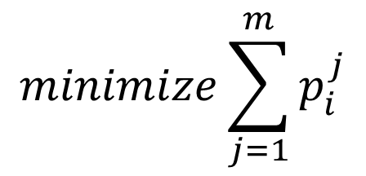
Optimization Formulation
$$minimize\sum_{j=1}^{m}{p_{i}^{j}}$$
Seemingly simple formulation
For every interval, minimize # TRXs
NP-Hard

Slide 33
Complexity 1/2
(δ + 1)th call incurs a sudden jump in power
Other calls bring a small increase in power (ε)
BTS Cost:
0 calls: 0
n calls: γ + nε
RED-BL: Minimum cardinality subset that covers J
Call this graph problem:
Modified MDS
Set δ = 0
Optimal solution will use fewest possible BTSs
BTS Power Consumption (kW)
At every BTS
First call incurs a sudden jump in power (γ)
δ
δ
t_{max}
Call volume
Set J
(Calls)
Set K
(BTSs)

Slide 34
Complexity 2/2
Make two copies of vertices
Place edges between each vertex and its copy
Replicate other edges in original graph
Solve Modified MDS on new graph
RED-BL for cellular
solves
Modified MDS
solves
MDS
A
A’
NP-Hard
NP-Hard
A
B
B’
MDS Solved!
B
C
C
C’
D
D’
D
Set K
(BTSs)
Set J
(Calls)
Minimum Dominating Set (MDS)
Smallest subset V’ of vertices V such that every other vertex is adjacent to at least one vertex in V’

Slide 35
Experimental Setup
Call volume traces for 2 days at 26 urban BTSs
Trace driven simulation:
Periodically obtain optimal call placement
Place BTSs with low-traffic in power-saving mode

Slide 36
BTS Power Consumption Models
Parameter | Value
 | Model 1 | Model 2 | Model 3
Idle Power (W) | 1425 | 2401.8 | 2341.5
Peak Power (W) | 1500 | 3887.5 | 2973.9
Power Saving per TRX (W) | 20 | 50 | 100

Slide 37
Results: Power-Saving Feature Only
Energy savings | Model 1 | Model 2 | Model 3
Percentage | 4.73% | 5.43% | 12.89%
Daily energy savings (kWh) | 43.28 | 109.68 | 217.12
Country-wide daily savings -31000 sites (MWh) | 51.6 | 130.77 | 258.87

Slide 38
Results: Power-Saving + Handoff Absolute Energy Savings (%)

Slide 39
Results: Power-Saving + Handoff Absolute Energy Savings (kWh)

Slide 40
Effect of Granular Deactivation
Granularity | Model 1 | Model 2 | Model 3
2-state | 5.38% | 6.29% | 14.94%
3-state | 6.81% | 7.73% | 18.62%
6-state | 8.70% | 9.65% | 23.37%
Savings increase with finer granularity

Slide 41
Effect of Late Deactivation

Slide 42
A Randomized Algorithm
Pick this
Nope
While there are BTSs in high-power mode
Pick a random BTS
For each call being handled by this BTS
Hand-over to a candidate BTS in low-power mode
Nope
Power saving
Yup!
Power saving

Slide 43
Performance of Heuristic Algorithm

Slide 44
Case Study II - Summary
Traffic has limited geo-flexibility compared to data centers
No geo-diversity in electricity prices
Activation of power savings feature in hardware helps
RED-BL achieves greater savings even for relatively conservative settings

Slide 45
Agenda
Background and motivation
Opportunity and key idea
Case studies:
Data centers (e.g., Facebook and Google)
Cellular networks (e.g., Sprint and Verizon)
Conclusions and future work

Slide 46
Conclusions
Opportunities for electricity cost savings using:
Workload relocation
Resource pruning
WR and RP are applicable to:
Data centers
Cellular networks
Others (need to explore)

Slide 47
Conclusions
Modeled electricity cost minimization as an optimal state trajectory problem
Showed the problem to be NP-Hard in the two case studies
Studied the sensitivity of the problem to various parameters

Slide 48
Conclusions
Data centers and cellular networks:
Sets of geo-diverse resources
Contrasts:
Availability of geo-diversity in electricity prices
Geo-flexibility in traffic
Magnitude of transition costs

Slide 49
Future Work
Factor in other forms of transition costs:
Cost of change in latency
Cost of replication
Cost of increase in call blocking probability
Implementation on software BTS
Incorporation into an OA&M framework
Adaptation to recent generations of cellular networks
Consider expensive diesel-generated power in cellular BTSs

Slide 50
Questions and Answers
If you can read this
Murphy’s law was violated

Slide 51
List of Papers
Published:
A simulation study of GELS for Ethernet over WAN, GLOBECOM 2007
RED-BL: Energy solution for loading data centers, INFOCOM Mini-Conference, 2012
Electricity cost efficient workload mapping, INFOCOM Computer Communications Workshop, 2013
Low-Carb: Reducing energy consumption in operational cellular networks, GLOBECOM 2013
RED-BL: Evaluating dynamic right sizing for data centers, Computer Networks, vol. 72, 2014
Submitted:
Low-Carb: A practical scheme for improving energy efficiency in cellular networks

Slide 52
Questions 1
Why not have one data center at the cheapest locations?
There is no single cheapest location
Diversity for:
Disaster
Latency

Slide 53
Question 2
Why can’t DVFS be used?
It can certainly be used
It does not achieve fine grained energy proportionality
Granularity of VF scaling is coarse
Other components are also energy proportional

Slide 54
Question 3
How many transitions in a day are likely?

Slide 55
Question 4
How quick is a transition?

